Slide 1


Slide 2



Internship/Project (3180701)
Review 1 (24/01/2024)
Online Proctor System
GTU Team ID: 404478
Team Member 1: Parth Ahuja (200570107024) 8EC2
Team Member 2: Savan Pethani (200570107006) 8EC2
Guided By
Internal Guide Name: Prof. Samir Kariya
Department of Computer Engineering, FOE (057)/FOPG (116)

Slide 3
Outline
Introduction
Abstract
System Analysis / Literature Review
ER Diagrams
Use Case Diagrams
Activity Diagram
Proposed Solution / System
Project Flow Chart / System Design
Tools & Technology to be used
Expected Outcomes
References

Slide 4
Introduction
Our project introduction signals a bold leap into the future of online examinations, where state-of-the-art technologies converge to redefine academic integrity and efficiency. Our vision is clear: to craft a platform that not only combats cheating head-on but also sets a new gold standard for secure and dependable online assessments. By leveraging tools like OpenCV, NumPy, Flask, and sophisticated AI techniques including face recognition and audio detection, our aim is to forge a comprehensive solution that fortifies the sanctity of the examination process.
Through the lens of face recognition technology, we're poised to authenticate students' identities with unprecedented precision, drastically minimizing the risks associated with identity fraud or unauthorized access. Concurrently, our arsenal of audio detection algorithms stands vigilant, enabling real-time monitoring to swiftly flag any suspicious activities like illicit communication or unauthorized aids. Beyond just bolstering security, these features promise to streamline the proctoring process, ensuring a seamless testing experience for both educators and students alike.
Looking ahead, the ripple effects of our project extend far beyond the present moment. As we pioneer the integration of AI-driven technologies in online assessments, we anticipate a seismic shift in global examination practices. Our aspiration is to arm educational institutions with a scalable, trustworthy solution that upholds the loftiest standards of fairness and integrity. Ultimately, our endeavor seeks to carve out a new path for online education—one where trust, security, and innovation intertwine to forge a more equitable learning landscape for all.

Slide 5
Abstract
Our project proposes an innovative Online Proctoring System to address the challenges of remote examinations in digital education. This system integrates various technologies to ensure fairness and maintain the credibility of online education, addressing the unique challenges of remote examinations.
The COVID-19 pandemic has accelerated the rise of online education, leading to a surge in Massive Open Online Courses (MOOCs). This has created challenges in maintaining the integrity of online assessments. A new project introduces an Online Proctoring System, a multimedia analytics platform, to address these issues.
The Online Proctoring System is a groundbreaking tool that collects audio-visual data during exams, uses advanced algorithms to detect cheating, and features a 360-degree security camera. It prioritizes examination integrity by analyzing cognitive, artistic, and technological parameters.
Our project addresses concerns about AI-based proctoring systems by proactively addressing student privacy and data security, ensuring ethical use of collected data, and alleviating concerns among the student community.

Slide 6
System Analysis / Literature Review
The system analysis and literature review indicate a growing trend towards integrating AI technologies in online exam applications. Studies, such as Smith et al. (2020), highlight the effectiveness of AI-driven proctoring systems in reducing cheating behaviors through features like facial recognition. Additionally, research by Johnson et al. (2019) underscores the importance of robust data security measures to safeguard exam content, enhancing trust among stakeholders.
Emerging trends in AI-driven exam applications, as seen in research by Chen et al. (2021), focus on adaptive testing and personalized feedback. These innovations leverage machine learning algorithms to tailor exam content to individual learning needs, improving assessment effectiveness and fairness. Overall, the literature underscores the transformative potential of AI in revolutionizing online exams, ensuring security, personalization, and efficiency in academic assessments.

Slide 7
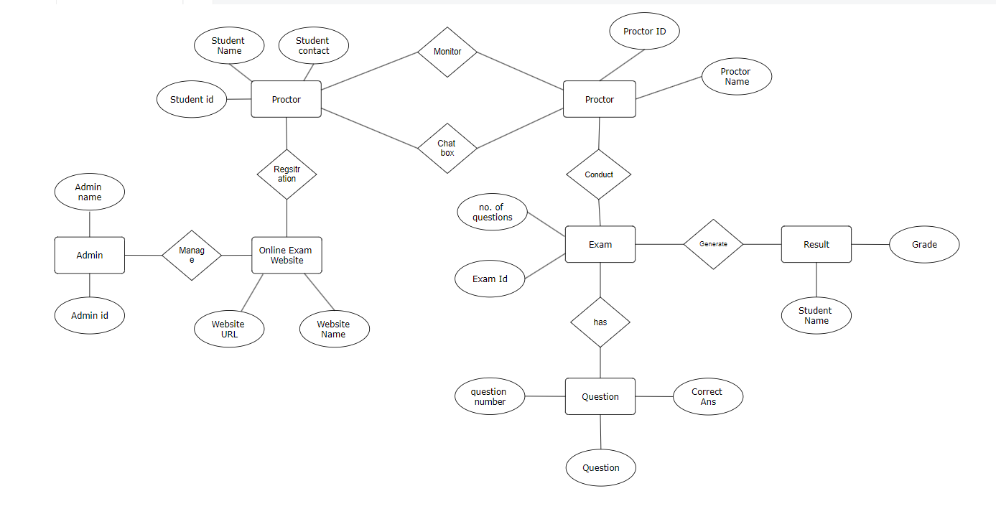
ER Diagram
ER Diagram

Slide 8
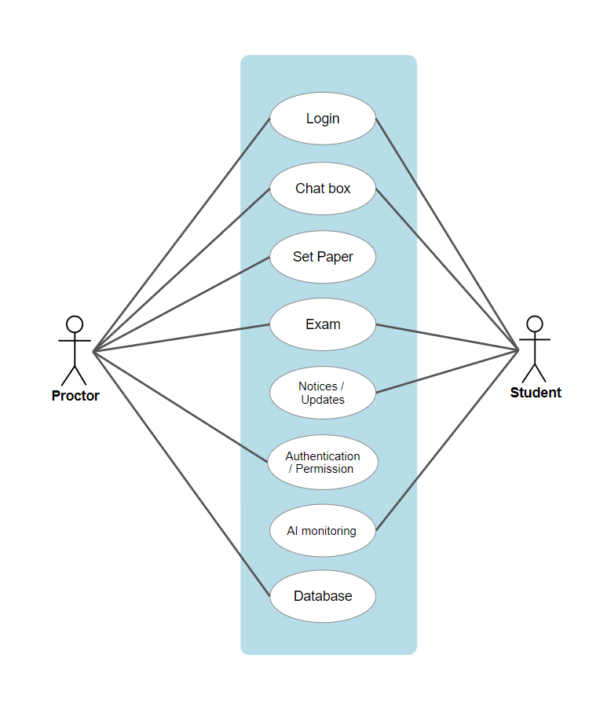
Use Case Diagram
Use Case Diagram

Slide 9
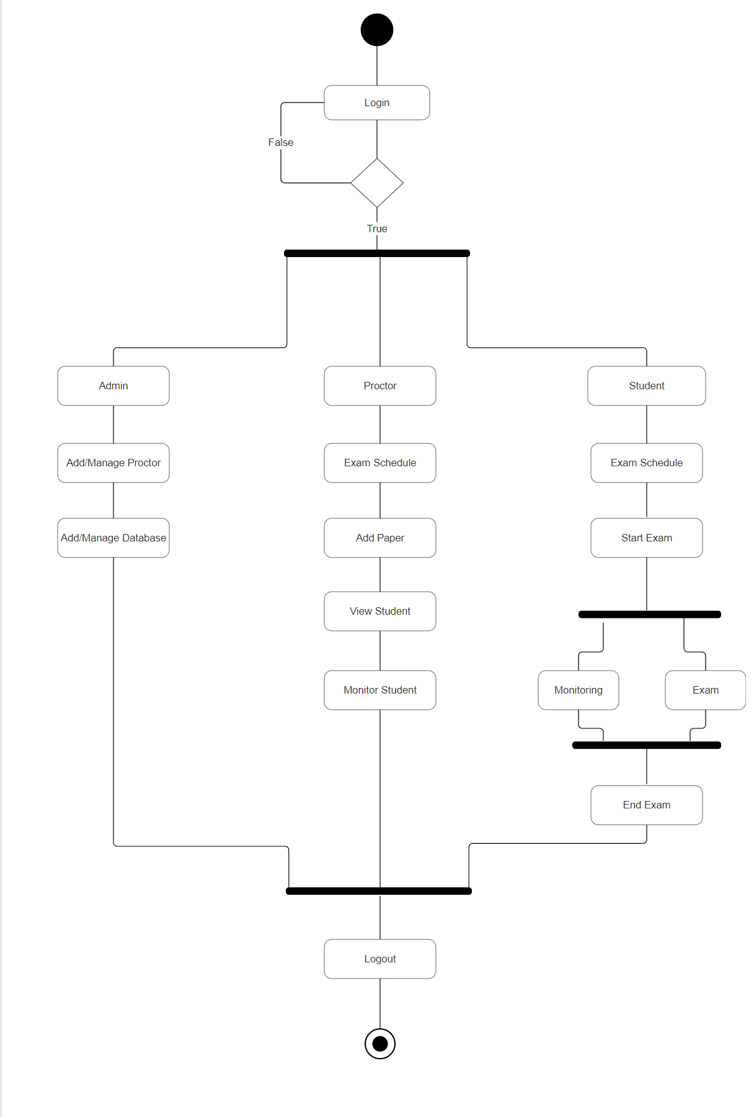
Activity Diagram
Activity Diagram

Slide 10
Proposed Solution
Our online exam application is designed to combat cheating by leveraging advanced AI technologies. Through features like face recognition and audio detection, we authenticate students' identities and monitor their behavior in real-time during exams. This proactive approach ensures a secure testing environment, minimizing the risk of unauthorized assistance or impersonation. By incorporating sophisticated algorithms for behavior analysis, we can swiftly detect any irregularities and intervene when necessary, upholding the integrity of the examination process.
Furthermore, our system prioritizes data security by employing robust encryption protocols to safeguard exam content from potential breaches or tampering. This not only protects the confidentiality of assessments but also maintains trust between educators and students. With the increasing reliance on online platforms for academic assessments, our solution offers a reliable and scalable approach to preserving academic integrity.
Overall, our online exam application represents a significant step forward in ensuring fair and reliable assessments in the digital age. By combining innovative AI technologies with stringent security measures, we provide a comprehensive solution that fosters trust and confidence among all stakeholders involved in the examination process.

Slide 11
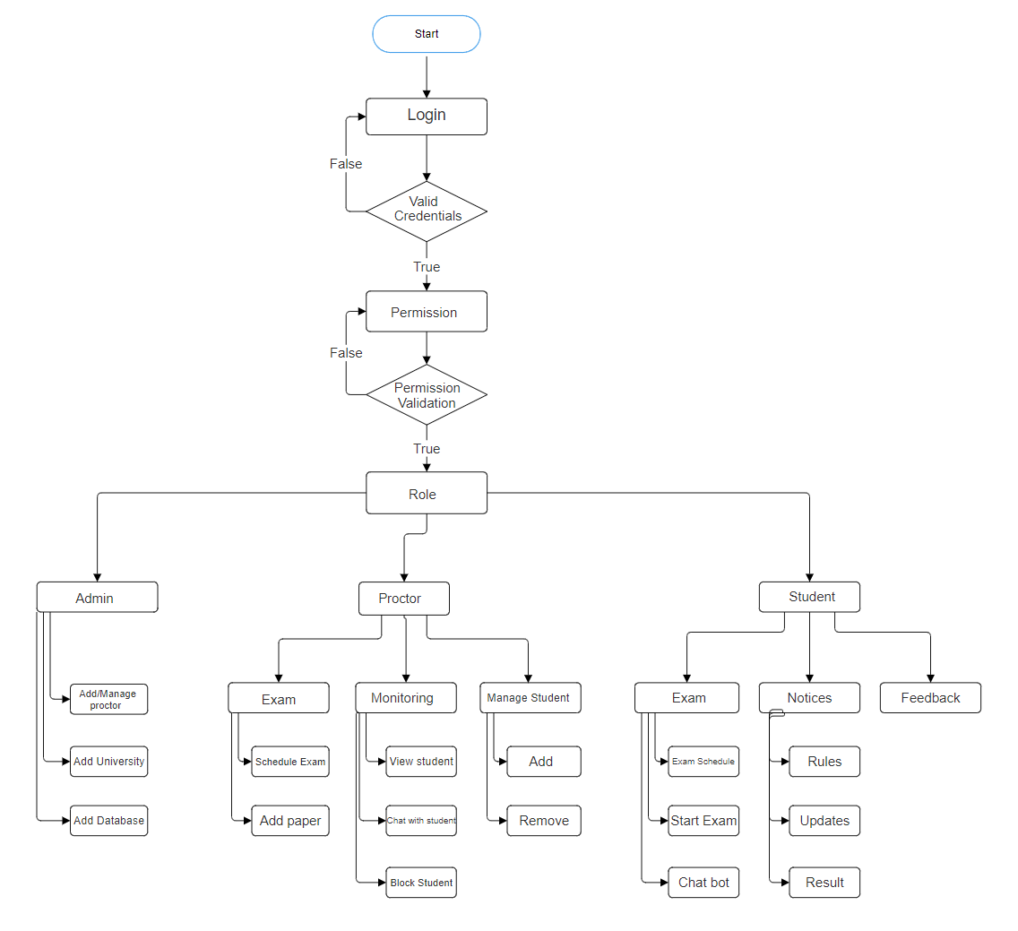
Project Flow Chart / System Design
Flow Chart

Slide 12
Tools & Technology to be used
Python
Opencv
Numpy
Flask
Mysql
TensorFlow
HTML
AI Models

Slide 13
Expected Outcomes
Implementing our online exam application with advanced AI technologies and robust security measures is expected to yield several positive outcomes. Firstly, we anticipate a significant reduction in cheating incidents during exams, thanks to the proactive monitoring and detection capabilities of our system. By discouraging dishonest behaviors and enhancing accountability, we aim to promote a culture of academic integrity within educational institutions.
Secondly, the implementation of stringent data security measures ensures the confidentiality and integrity of exam content, instilling confidence among educators and students regarding the privacy of their assessments. This not only protects sensitive information but also fosters trust in the reliability of online exams as a legitimate assessment method.
Lastly, we anticipate improved efficiency in exam administration processes, as the automated features of our application streamline identity verification, monitoring, and data management tasks. This allows educators to focus more on the quality of assessments and student engagement, ultimately enhancing the overall academic experience for both instructors and learners.

Slide 14
References
[1] “An intelligent system for online exam monitoring,” IEEE Conference Publication | IEEE Xplore, Aug. 01, 2016. https://ieeexplore.ieee.org/abstract/document/7845315/
[2] “Automated online exam proctoring,” IEEE Journals & Magazine | IEEE Xplore, Jul. 01, 2017. https://ieeexplore.ieee.org/abstract/document/7828141/
[3] T. S. Kumar and G. Narmatha, “Video analysis for Malpractice Detection in classroom examination,” in Advances in intelligent systems and computing, 2015, pp. 135–146. doi: 10.1007/978-81-322-2671-0_13.
[4] L. C. O. Tiong, “E-Cheating Prevention Measures: Detection of cheating at online examinations using deep learning approach -- a case study,” arXiv.org, Jan. 25, 2021. https://arxiv.org/abs/2101.09841
[5] “On continuous user authentication via typing behavior,” IEEE Journals & Magazine | IEEE Xplore, Oct. 01, 2014. https://ieeexplore.ieee.org/abstract/document/6879297
[6] Y. Zhang, X. Liu, M.-C. Chang, W. Ge, and T. Chen, “Spatio-Temporal phrases for activity recognition,” in Lecture Notes in Computer Science, 2012, pp. 707–721. doi: 10.1007/978-3-642-33712-3_51.

Slide 15


